Slide 1
Chapter #2 Probability
Probability of an event

Slide 2
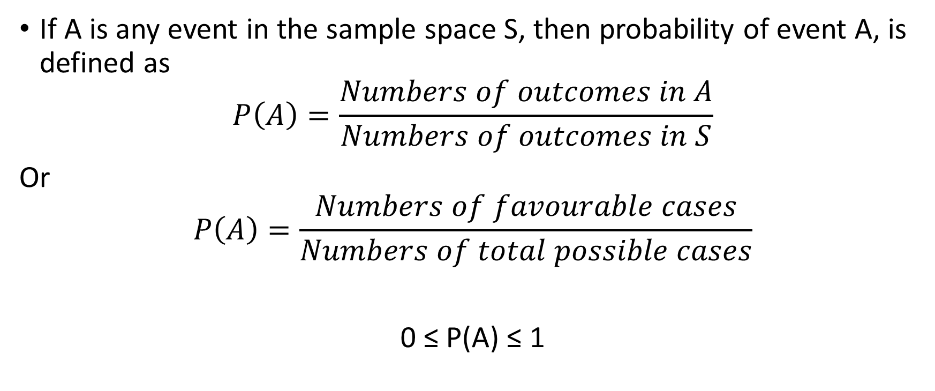
Probability
If A is any event in the sample space S, then probability of event A, is defined as
$$P\left(A\right)=\frac{Numbers of outcomes in A}{Numbers of outcomes in S}$$
Or
$$P\left(A\right)=\frac{Numbers of favourable cases}{Numbers of total possible cases}$$
0 ≤ P(A) ≤ 1

Slide 3
Q A six side die is tossed only once. What is the probability of getting: a) an even number b) a number less than 3 c) a 4 or higher number d) a number fro 1 to 6

Slide 4
Q) A card is drwn at random from an ordinary pack of 52 playing cards. Find the probability that card a) is a jack b) not jack

Slide 5
Q) A fair coin is tossed three times. What is the probability of getting a) Exactly 2 heads b) at least two head

Slide 6
Q) A pair of dice is rolled once what is probability of getting a) a total of 6 b) a total of 13

Slide 7
Q) A coin is tossed twice. What is the probability that at least 1 head occurs?

Slide 8
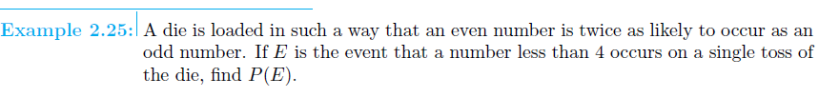

Slide 9
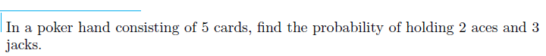

Slide 10
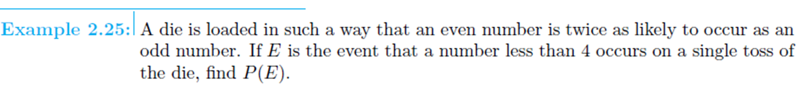

Slide 11
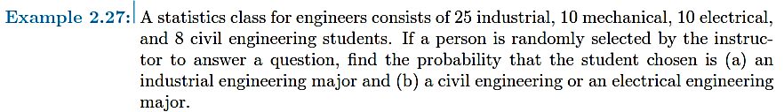

Slide 12
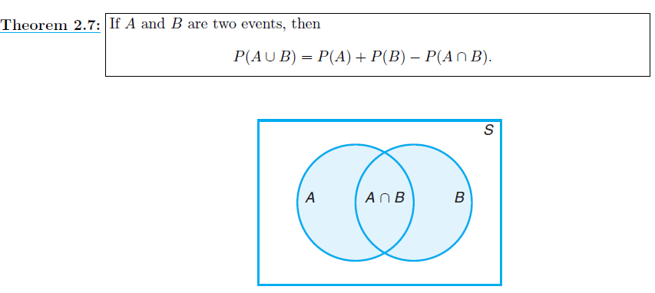

Slide 13
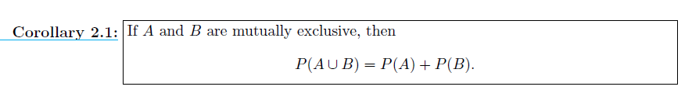

Slide 14
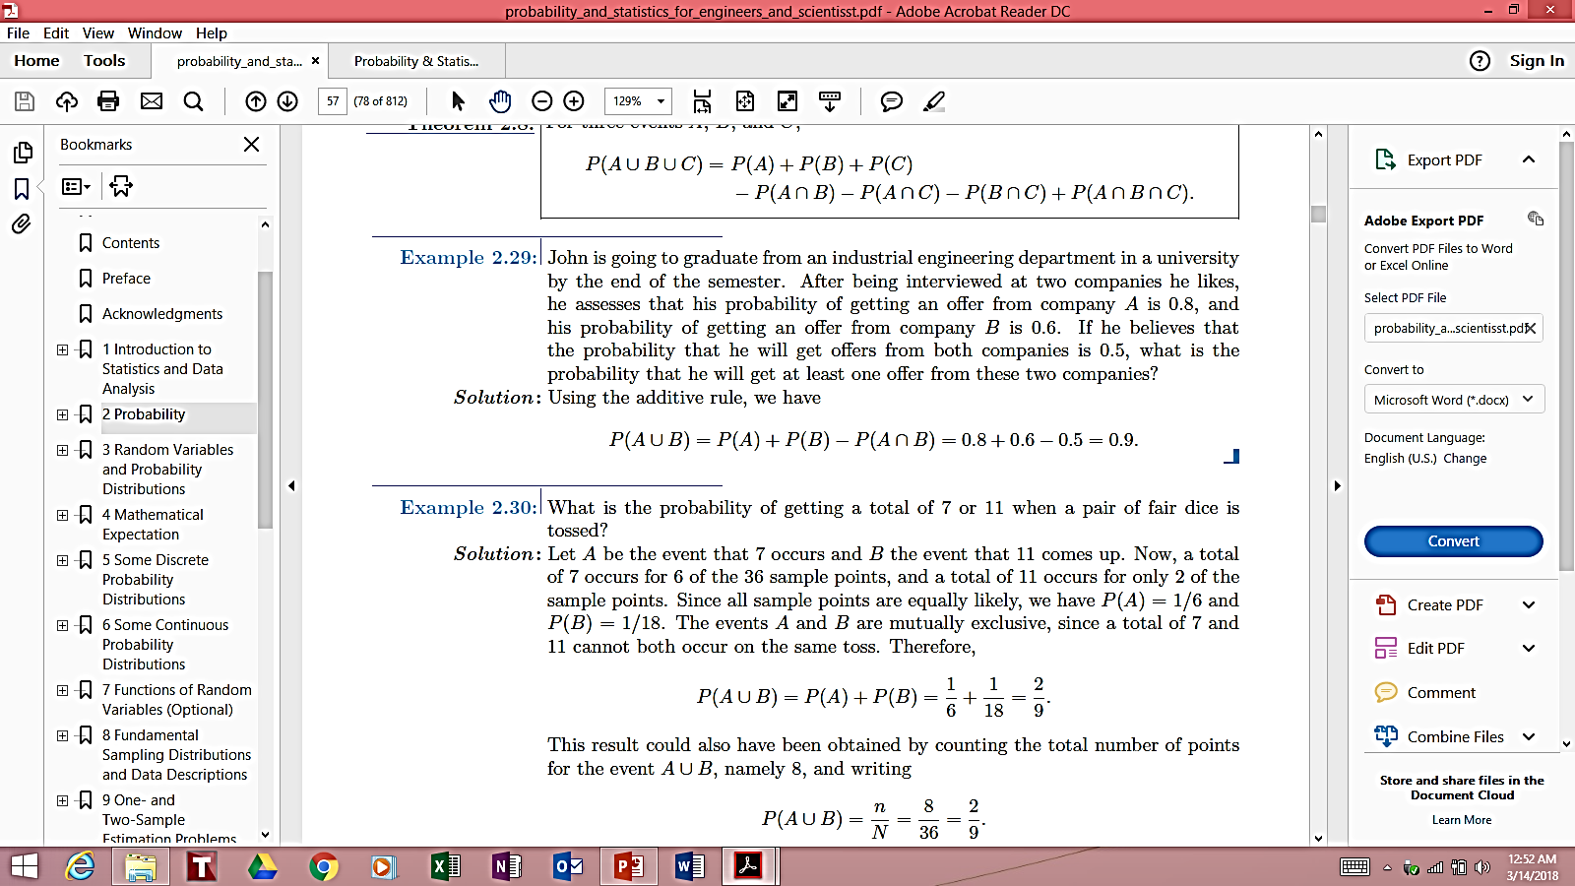

Slide 16
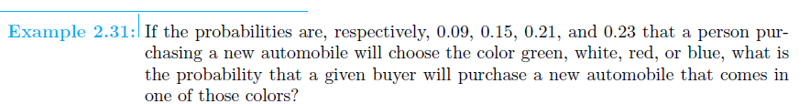

Slide 17
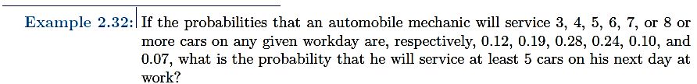

Slide 18
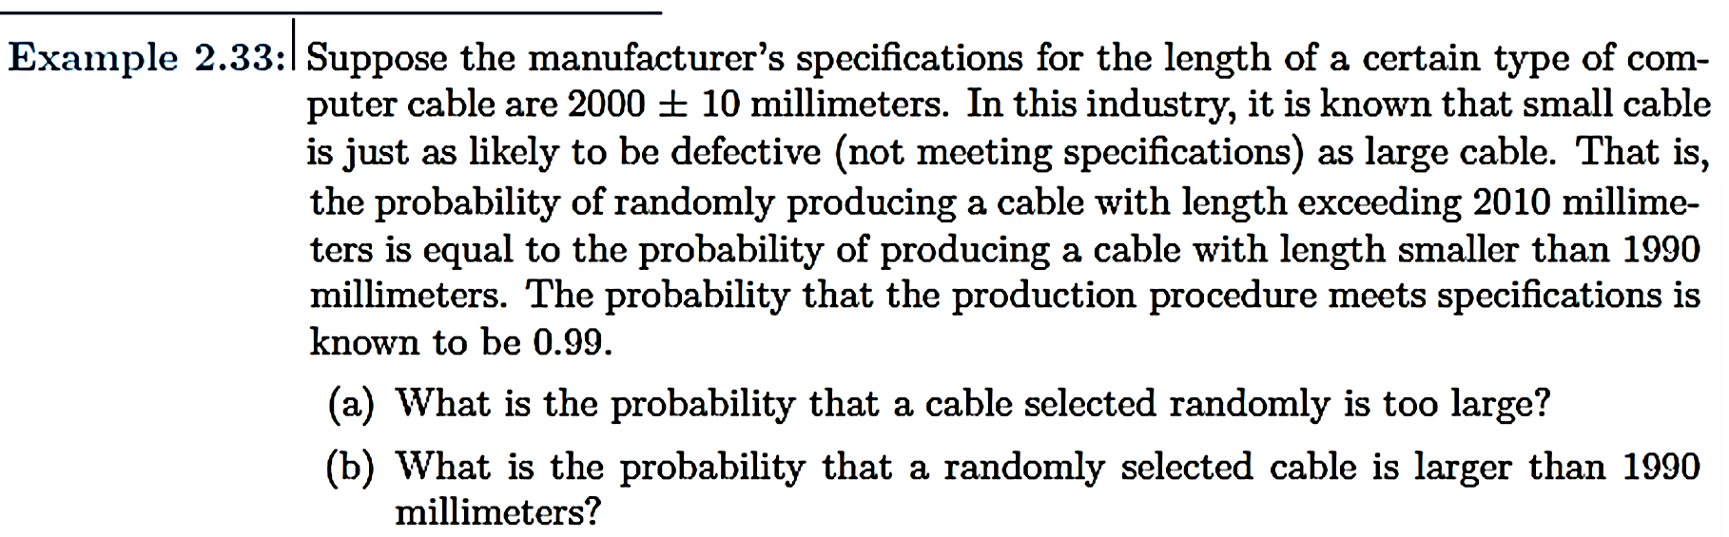

Slide 19
Ex 2.51 – 2.70

Slide 20
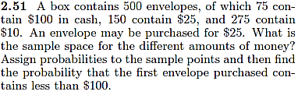

Slide 21
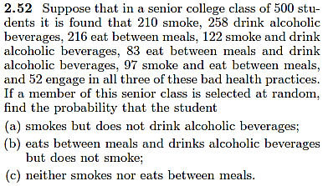

Slide 22
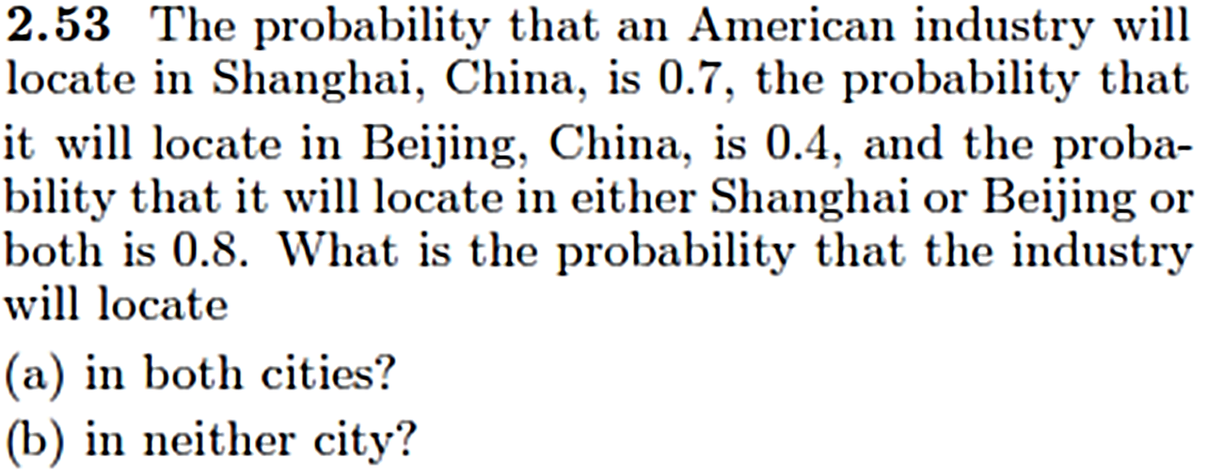

Slide 23
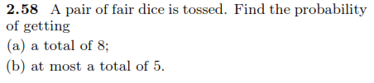

Slide 24
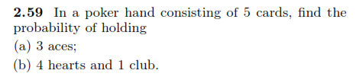

Slide 25
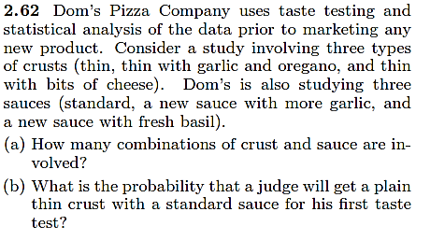

Slide 26
